Slide 1
Digital transformation with Azure and Azure Stack
BRK2108
Jeffrey Snover
Technical Fellow
Azure Stack Architect
Mark Russinovich
Technical Fellow
Azure CTO

Slide 2

Digital transformation with Azure and Azure Stack
BRK2108
Jeffrey Snover
Technical Fellow
Azure Stack Architect
Mark Russinovich
Technical Fellow
Azure CTO

Slide 3
Azure Stack is new
Don’t project the past onto it

Slide 4
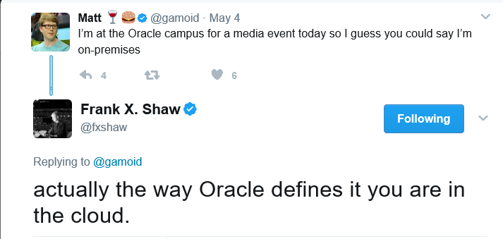
Made worse by “cloud washing”

Slide 5






Don’t get boxed in
Future proof yourself
CLOUD
VMW + AWS
Hosted virtualization
Azure + Azure Stack
Only consistent hybrid cloud

Slide 6



Migrating to Azure
ANNOUNCING
Azure Migrate
Azure Database Migration Service
Azure
Data Box
Discover
Migrate
Azure Cost
Management
Azure Hybrid Benefit
Free for all Azure customers
Windows Server
SQL Server
Optimize

Slide 7


Azure Stack is an extension of Azure Only consistent hybrid cloud platform
Consistency
Azure
Azure Stack

Slide 8
The right way to think about Azure Stack
What it is
What it isn’t
First consistent Hybrid Cloud Platform
Virtualization-replacement play
Integrated system with IaaS & PaaS
DIY infrastructure
Regularly updated for Azure-consistency
Static system you deploy & forget
Truly open and flexible (just like Azure)
.NET/Windows only

Slide 9
Why?

Slide 10
Azure enables customer’s Digital Transformation
Azure Stack extends Azure to more customers

Slide 11
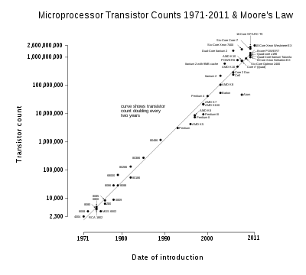
You’ve heard of “Moore’s Law”

Slide 12

The Other Moore’s Law
Core
Differentiation that
wins customers
Context
Everything else
Core
Differentiation that wins customers
Context
Everything else
Mission Critical Failure=> Deep trouble
Mission Critical failure=> deep trouble
$$$
Risk
$$$
Risk
Enabling
Enabling
Everything else
Innovate
Housekeeping
*Geoffrey Moore http://ecorner.stanford.edu/videos/1327/Core-and-Context

Slide 13
The Other Moore’s Law
Core
Differentiation that
wins customers
Context
Everything else
Core
Differentiation that wins customers
Context
Everything else
Killing fields of many once-great companies
Standardize
Automate
Offload
Reduce RISK by reducing COMPLEXITY
Mission Critical Failure=> Deep trouble
Focus
De-Risk
Mission Critical failure=> deep trouble
$$$
Risk
Enabling
Enabling
Everything else
Innovate
Housekeeping

Slide 14
Digital Transformation Strategy
Build what differentiates you
Differentiated applications
Buy what doesn’t
Infrastructure
Solve the mission critical/context dilemma by using Azure/Azure Stack
Reduce complexity
Centralize, Standardize, Automate, Outsource

Slide 15
Applying the other Moore’s Law
Old IT
Physical Servers and Virtual Machines
On-premises, non-cloud

Slide 16
Applying the other Moore’s Law
Old IT
New IT reality
Physical Servers and Virtual Machines
On-premises, non-cloud
Hybrid cloud

Slide 17
Applying the other Moore’s Law
Old IT
New IT reality
Implementation
Physical Servers and Virtual Machines
On-premises, non-cloud
Hybrid cloud
Public cloud
off-premises
Cloud
on-premises

Slide 18
Applying the other Moore’s Law
Old IT
New IT reality
Implementation
Tactic
Solution
Physical Servers and Virtual Machines
On-premises, non-cloud
Hybrid cloud
Public cloud
off-premises
Cloud native
Azure PaaS
Lift and modernize
Azure Containers
Lift and shift
Azure IaaS
Commodity
SaaS: Microsoft Dynamics, Office 365, VSTS
Cloud
on-premises
Cloud native
Azure PaaS
Leave it alone
Azure Stack

Slide 19
Cloud allows customers to focus their energy on building what differentiates them: customer focused applications
This is the heart of Digital Transformation

Slide 20
3 Azure Stack promises

Slide 21
Azure Stack promise
Consistent
application development
Azure services
available on-premises
Integrated
delivery experience

Slide 22
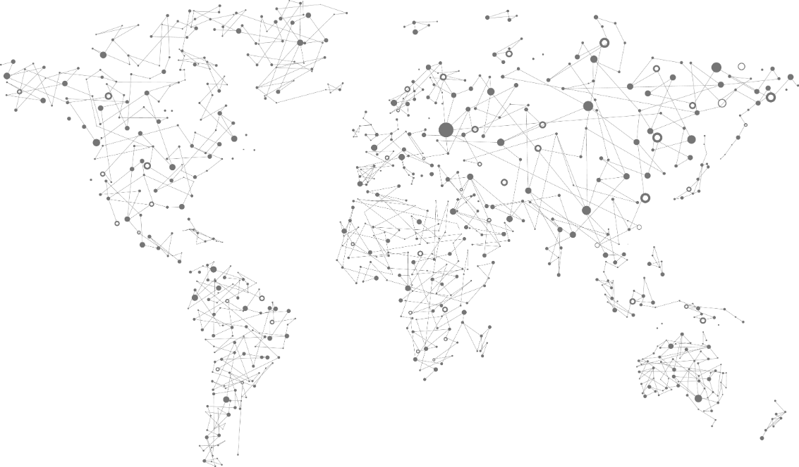
Azure services everywhere
42 Azure regions
100s of service providers
1,000s of enterprises

Slide 23












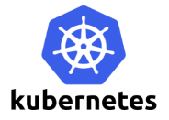


One Azure ecosystem
Solutions get maximal addressable market
Customers get maximal choice of solutions
Employers and employees benefit
Note: Ecosystem requires version consistency
Goal: Applications and services that are certified for Azure work on Azure Stack

Slide 24

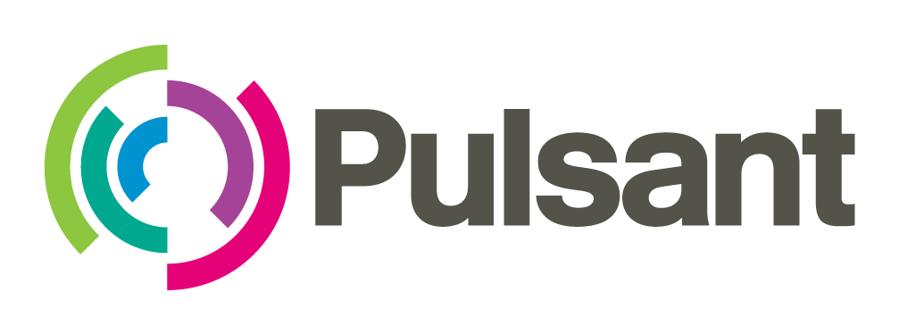











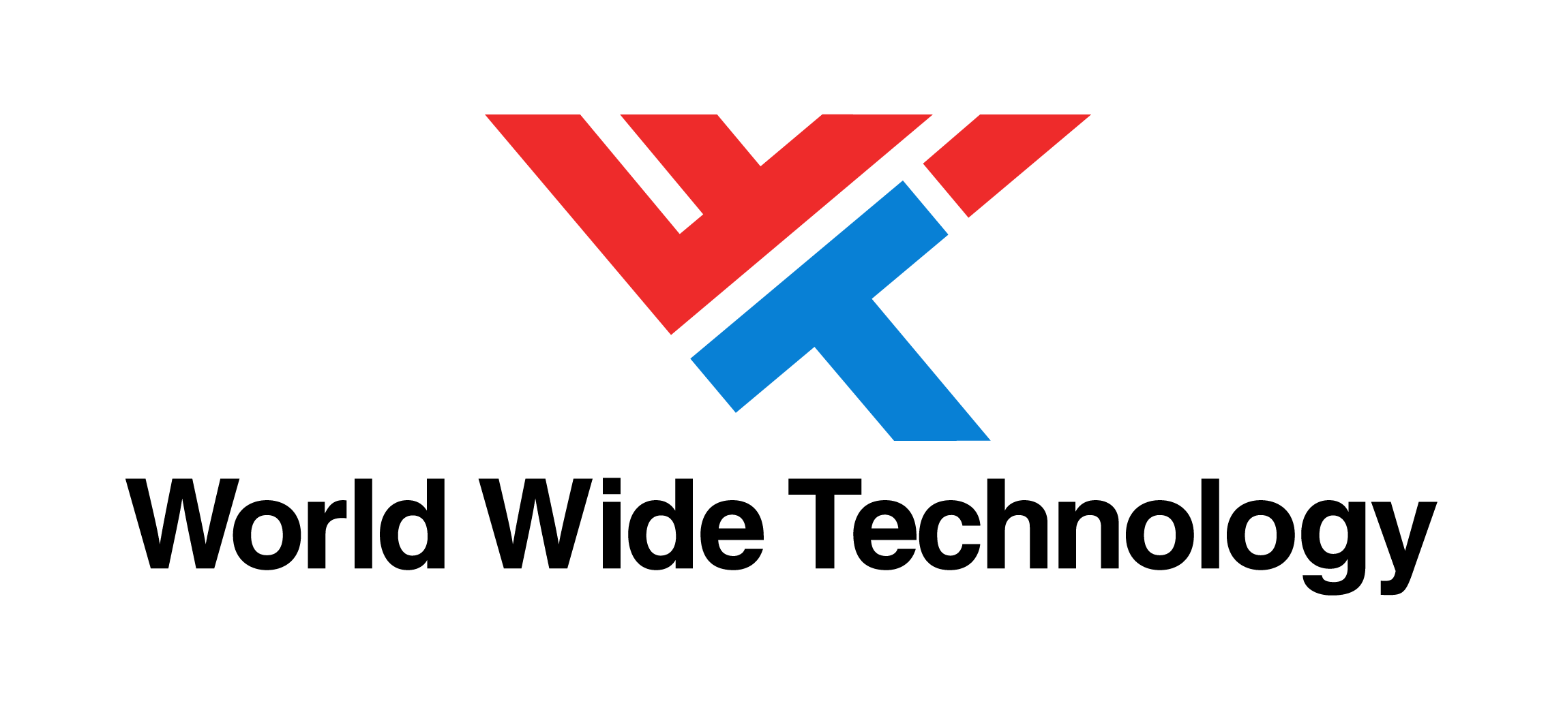


United Kingdom
Norway
Sweden
Switzerland
Finland
Netherlands
United States
Extending geographic reach for Azure services
Domain, industry, and regulatory expertise
Managing and operating Azure Stack on your behalf
New Zealand
Realizing Azure services everywhere with Managed Service Provider solutions

Slide 25


Integrated delivery experience
Integrated systems
Fast to deploy
Pay-as-you-use
Integrated support, broadly available
Get up and running quickly
Deliver 100s of VMs initially (and grow over time)
Extension of Azure model
Receive one bill
Consistent support experience, no matter who you call
Available in 46 geos initially
Roadmap: Cisco systems are ready to order as of September 2017. Huawei integrated systems will be available in Q1 CY18.

Slide 26
Use cases

Slide 27
Hybrid use cases: Azure and Azure Stack
Edge and disconnected solutions
Cloud applications to meet varied regulations
Cloud application
model on-premises

Slide 28



Deploy Azure Stack for:
Real-time latency requirements
Connectivity issues
Local data processing
Use Azure for aggregate analytics and big data modelling
Common application logic across both, connected, or disconnected
Edge and disconnected solutions

Slide 29



Develop and deploy global application in Azure
Optionally deploy to Azure Stack to handle customer preferences for regulations:
Government
Industry
Region
No changes to application
Cloud applications to meet varied regulations

Slide 30
Demo
Cloud apps that meet varied regulations: Deploying Blockchain across Azure and Azure Stack
Mark Russinovich

Slide 31
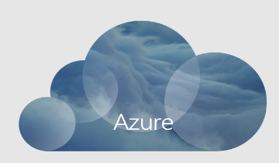
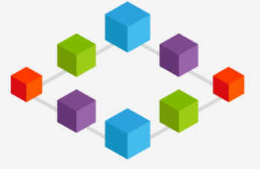
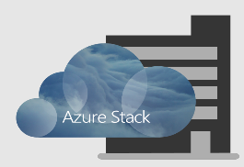
Demo
Mark Russinovich

Slide 32



Apply modern architectures to on-premises apps not yet ready for cloud
PaaS
Serverless computing
Microservices and containers
Move to Azure without code changes
Consistent programming model, skills, and processes
Cloud application model on-premises

Slide 33












Customers
Edge and disconnected solutions
Cloud applications to meet varied regulations
Cloud application
model on-premises

Slide 34
Details

Slide 35

Azure and Azure Stack Truly consistent hybrid cloud platform
Portal | PowerShell | DevOps tools
Portal | PowerShell | DevOps tools
Azure Resource Manager
Developers
Azure Resource Manager
Azure IaaS | Azure PaaS Compute | Network | Storage | App Service | Service Fabric*
CONSISTENCY
IaaS | PaaS
Cloud-inspired infrastructure
Cloud infrastructure
IT
Microsoft Azure Stack
Private | Hosted
Microsoft Azure
Public
Sealed hosts
Integrated Systems Hardware
Sealed hosts
Azure-designed Hardware

Slide 36

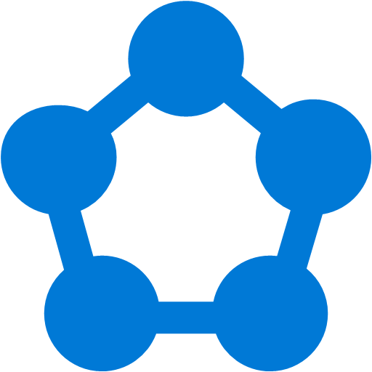
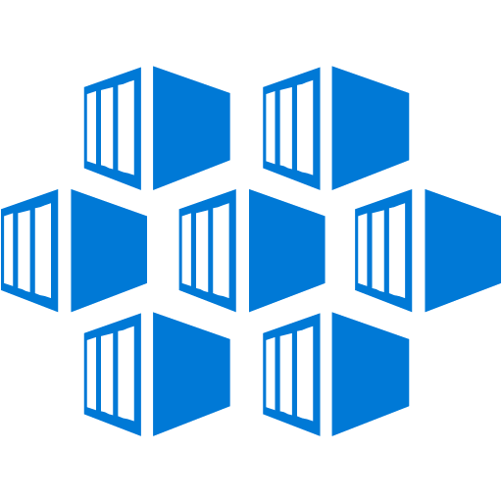
Azure PaaS available on-premises: High productivity development
Azure App Service
Azure Functions
Azure Service Fabric
Azure Container Service (ACS)
Cloud Foundry
Web, Mobile, and API apps
Serverless Computing
Scalable distributed applications, deploy standalone Service Fabric clusters initially
Container management, with ACS engine support for Docker Swarm, Kubernetes, and Mesosphere DC/OS
Open source platform
Roadmap: Azure Service Fabric-as-a-Service and Azure Container Service-as-a-Service are planned to be available in CY18

Slide 37

Azure IaaS available on-premises: Beyond traditional virtualization
Virtual
machines (VM),
VM scale sets
Containers
with Docker
Networking
Storage
Key Vault
Rapid deployment with automated scaling
Linux and Windows Server containers
Virtual network, load balancer, VPN gateway
Blobs, tables, queues
Securely protect application keys and secrets
Roadmap: Additional Azure consistency (New VM types, Managed Disks, storage API updates) in CY18. Windows Azure Pack Connector for Azure Stack in CY17.

Slide 38
Integrated systems

Slide 39
Azure Stack Internals
ARM LAYER
Azure Portal (UX)
Templates/PowerShell/CLI, SDK, etc
Azure Resource Manager (ARM)
RP LAYER
PARTITION REQUEST BROKER
FRP
SRP
CRP
NRP
HRP
URP
…
Internals are Internal
INFRASTRUCTURE CONTROL LAYER
Infrastructure Deployment
PHYSICAL
NODE
MANAGEMENT
STORAGE CONTROLLER
COMPUTE CONTROLLER
NETWORK CONTROLLER
INFRA ROLE CONTROLLER
HEALTH CONTROLLER
Bootstrap
Patch & Update
Scale Out
INFRASTRUCTURE ROLES
Workflows
ACS
NETWORK CONTROLLER
COMPUTE CONTROLLER
HEALTH CONTROLLER
INFRA ROLE CONTROLLER
ARM
UPDATE MGMT
DIRECTORY MGMT
FRU
RESET
STORAGE CONTROLLER
EDGE GATEWAY
INFRA MGMT
CONTROLLER
PARTITION
REQ BROKER
ADFS
Builds
START
LB MUX
PHYSICAL NODE MGMT
INTERNAL DATA STORE
CERTIFICATE MGMT
STOP
INFRA DEPLOYMENT
HARDWARE LAYER
NETWORK (SWITCHES)
COMPUTE
STORAGE

Slide 40



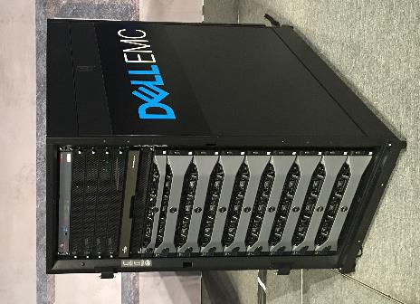
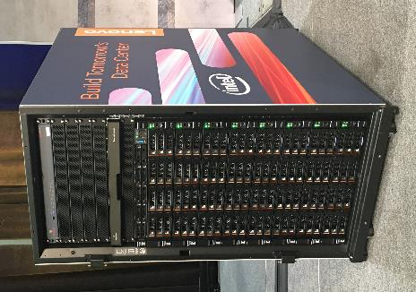
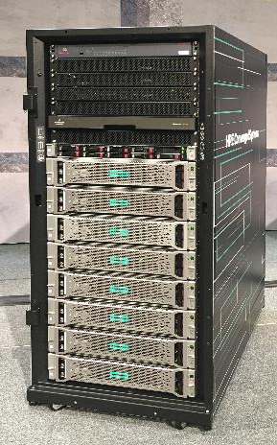

Slide 41

Azure Stack infrastructure lifecycle
Continuous flow of innovation from Azure to Azure Stack
Architecture, hardware, and topology
Deployment, configuration, provisioning
Validation
Monitoring, diagnostics
Security and privacy
Business continuity
Patching and updates
Field replacement of parts

Slide 42

Integration in your datacenter
Border Device
Datacenter monitoring/ticketing/ hardware monitoring
Azure Stack
Aggregate Switch
Aggregate Switch
ToR Switch
ToR Switch
ToR Switch
ToR Switch
Identity integration
(Tenant and Cloud Admin)
BMC Switch
BMC Switch
Server
Server
Server
……….
Server
Server
Server
Space, power, and cooling
Server
Server
Scale Unit 1
Scale Unit n

Slide 43
Demo
Azure Stack Operator experience (including monitoring, marketplace syndication, and updates)
Charlie Satterfield

Slide 44
Announcing: A new learning path to advance your career
New Azure Stack operator training courses and certification exam (available in Q1 CY18)
Start your journey to be a certified Azure Stack operator today

Slide 45
Two ways to get Azure Stack
As an integrated system
As a fully managed service
Customer controls management and operations (DIY or via SI)
Two contracts: one for Azure services and another for hardware
Typically hosted at customer premises
Example: Customer purchases Azure services from Microsoft, integrated systems from Dell EMC/HPE/Lenovo
Managed service provider does management and operations
Single point of purchase, one contract
Typically hosted at managed service provider premises
Example: Customer purchases a complete solution from Avanade or one of many other Azure MSPs
One integrated support experience

Slide 46
Roadmap and recap

Slide 47
Roadmap Note: Subject to change
Jul 2017
Sep 2017
Rest of CY2017
Into CY2018
ASDK available for download
Integrated Systems available to order
Building supply chain volume
Optimizing availability & reliability
Adding scale (add server incrementally, upto 16 servers per scale unit)
Multi-region support for enhanced scale and business continuity
Support for new VM types
Managed Disks
Azure Service Fabric and Azure Container Service delivered as-a-Service
First integrated systems start shipping
(46 countries)

Slide 48
Azure enables customer’s Digital Transformation
Azure Stack extends Azure to more customers

Slide 49
The right way to think about Azure Stack
What it is
What it isn’t
First consistent Hybrid Cloud Platform
Virtualization-replacement play
Integrated system with IaaS & PaaS
DIY infrastructure
Regularly updated for Azure-consistency
Static system you deploy & forget
Truly open and flexible (just like Azure)
.NET/Windows only

Slide 50
Get going with Azure Stack
1
2
3
Develop
applications in Azure
Validate
Download Azure Stack Development Kit
Deploy
Order Azure Stack integrated systems for production deployment
Start your journey to be a certified Azure Stack operator today

Slide 51

Azure Stack Customer immersion
Are you interested in Azure Stack, but aren’t sure of how it will relate to you and your business? Are you looking for deeper education and a hands-on learning experience? Then join us in the Immersion Zone for the “Azure Stack Solutions” experience, where we will provide you the tools to define, develop and deliver a solution on the Azure Stack platform!
Small group session
Interactive experience
End-to-end view of Azure Stack
Offered Mon–Friday in the Immersion Zone
Space is limited! Sign up in person at the Hyatt Regency—Immersion Zone

Slide 52

Ever wondered what it would be like to operate Azure Stack? Get started right now using only your laptop and an internet connection. This MOOC-style experience will take you through the basics of being an Azure Stack operator in a tutorial-like fashion. What’s better? You can do all of this from the comfort of your hotel room!
Azure Stack Hands on experience
Step into the shoes of a cloud operator
A complete hands-on experience
Step-by-step instruction guide
Access from anywhere, anytime this week
Come to the expo area to get your coupon code and we will get you started!

Slide 53
Have feedback on Azure Stack?
Want to provide your feedback direct to the engineering team?
Join the Azure Stack customer research panel : https://aka.ms/azssession

Slide 54
Related Content
You are here
BRK3084 | Microsoft Azure Stack hybrid apps and developer overview | Bradley Bartz
BRK2138 | Incorporating Microsoft Azure Stack in your Hybrid Cloud Strategy | Natalia Mackevicius
BRK2108 | Digital transformation with Microsoft Azure and Azure Stack | Jeffrey Snover | Mark Russinovich | Mark Russinovich
BRK3127 | Operating principles of Microsoft Azure Stack | Daniel Savage | Charlie Satterfield | Charlie Satterfield
BRK3088 | Microsoft Azure Stack Development Kit and why it matters | Charles Joy
BRK3150 | Understanding Microsoft Azure Stack through the lens of customer use cases | Bradley Bartz | Filippo Seracini | Filippo Seracini
BRK2094 | Microsoft Azure Stack delivery and operations overview | Vijay Tewari
BRK2093 | Microsoft Azure Stack business and support model | Alfredo Pizzirani
BRK2091 | Azure App Service on Microsoft Azure Stack, developer Ninjitsu: Above and below the clouds! | Andrew Westgarth
BRK2106 | Deploying, managing, and supporting Azure App Service on Microsoft Azure Stack | Andrew Westgarth
BRK3089 | Microsoft Azure Stack security and compliance | Filippo Seracini | Jeffrey Snover | Jeffrey Snover
BRK4010 | Microsoft Azure Stack business continuity and disaster recovery | Hector Linares
BRK4015 | DevOps on Microsoft Azure Stack | Matthew McGlynn | Anjay Ajodha | Anjay Ajodha
BRK3115 | IaaS on Microsoft Azure Stack | David Armour | Scott Napolitan | Scott Napolitan
BRK3099 | Developing hybrid apps on Microsoft Azure Stack | Ricardo Mendes
BRK3149 | Understanding Azure Stack architecture and how to capacity plan solution purchases | Spencer Shepler
BRK3122 | Making it real: How Azure Stack was implemented in production at a large hoster in the Nordics | Anders Ravnholt | Joni Leskinen | Joni Leskinen
BRK3116 | Integrating Azure Stack into your Datacenter | Thomas Roettinger
BRK3114 | How to expand your Azure Stack marketplace with production ready solutions | Marc van Eijk
BRK3090 | Microsoft Azure Stack usage and billing | Alfredo Pizzirani
BRK4011 | Microsoft Azure Stack identity, multi-tenancy, and role-based access control | Shriram Natarajan
BRK2095 | Microsoft Azure Stack, the journey and its findings | Christer Olsson | Alexander Ortha | Alexander Ortha
BRK2143 | Lessons learned from the Azure Stack Early Adoption Initiative | Joel Yoker | Pat Telford | Pat Telford
THR3007 | Updating and servicing Microsoft Azure Stack | Justin Incarnato
THR3006 | Recovering Azure Stack infrastructure from a catastrophic data loss | Hector Linares
THR2017 | Microsoft Azure Stack role guide and certifications | Cheng Wei
PRE25 | Drive successful Azure Stack deployments
THR1008 | Truly consistent hybrid cloud with Microsoft Azure | Ananthanarayan Sundaram | Vanessa Alvarez | Vanessa Alvarez

Slide 55
Please evaluate this session
From your
Please expand notes window at bottom of slide and read. Then Delete this text box.
PC or tablet: visit MyIgnite https://myignite.microsoft.com/evaluations
Phone: download and use the Microsoft Ignite mobile app https://aka.ms/ignite.mobileapp
Your input is important!

Slide 56
The information herein is for informational purposes only and represents the current view of Microsoft Corporation as of the date of this presentation. Because Microsoft must respond to changing market conditions, it should not be interpreted to be a commitment on the part of Microsoft, and Microsoft cannot guarantee the accuracy of any information provided after the date of this presentation. MICROSOFT MAKES NO WARRANTIES, EXPRESS, IMPLIED OR STATUTORY, AS TO THE INFORMATION IN THIS PRESENTATION.

Slide 57
BACKUP

Slide 58
Azure Stack security

Slide 59
Azure Stack internals
ARM LAYER
Azure Portal (UX)
Templates/PowerShell/CLI, SDK, etc
Azure Resource Manager (ARM)
RP LAYER
PARTITION REQUEST BROKER
Internals are internal
FRP
SRP
CRP
NRP
HRP
URP
…
INFRASTRUCTURE CONTROL LAYER
Infrastructure Deployment
PHYSICAL
NODE
MANAGEMENT
STORAGE CONTROLLER
COMPUTE CONTROLLER
NETWORK CONTROLLER
INFRA ROLE CONTROLLER
HEALTH CONTROLLER
Bootstrap
Patch & Update
Scale Out
INFRASTRUCTURE ROLES
Workflows
ACS
NETWORK CONTROLLER
COMPUTE CONTROLLER
HEALTH CONTROLLER
INFRA ROLE CONTROLLER
ARM
UPDATE MGMT
DIRECTORY MGMT
FRU
RESET
STORAGE CONTROLLER
EDGE GATEWAY
INFRA MGMT
CONTROLLER
PARTITION
REQ BROKER
ADFS
Builds
START
LB MUX
PHYSICAL NODE MGMT
INTERNAL DATA STORE
CERTIFICATE MGMT
STOP
INFRA DEPLOYMENT
HARDWARE LAYER
NETWORK (SWITCHES)
COMPUTE
STORAGE

Slide 60

Security best practices
Microsoft Secure Development Lifecycle
Threat modeling of each components
Two 3rd party penetration testers
Automatic Patching & Update of the entire infrastructure (including firmware)

Slide 61

Security principles: hardened
HW security features (e.g., secure boot, UEFI)
Windows Server 2016 security features
Credential Protection (Credential Guard)
Code Integrity (Device Guard)
Antimalware (Windows Defender)
Disabled legacy protocols (e.g., NTLM)
Security OS baseline (Military STIGs)
Encryption of data at rest/network traffic
Strong authentication with dedicated AD & CA

Slide 62

Security principles: assume breach
Simplified auditing
Locked down infrastructure
No access to infrastructure components
Least-privileged/whitelisted intercomponent communications
Application whitelisting
Network ACLs
Least-privileged service accounts
Constrained/compartmentalized administration
Predefined, whitelisted admin experience
Fine-grained RBAC
Break-the-glass “Privileged Endpoint”
Immutable Infrastructure

Slide 63
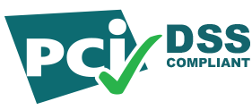



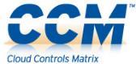
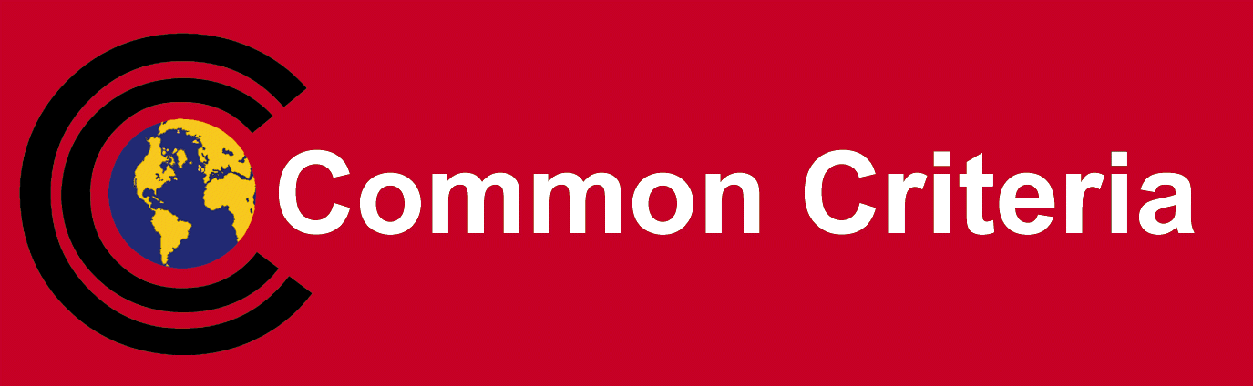
Pre-validation for compliance standards
Formal assessment of Azure Stack Infrastructure by 3PAO
Precompiled documentation for applicable controls
Technology
Infrastructure
Tenant Applications
People
Process

Slide 64
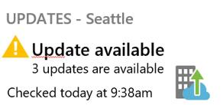
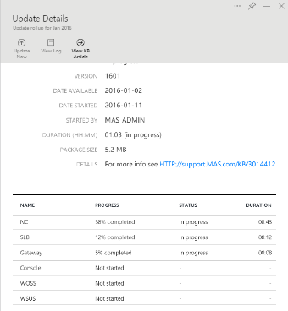
Azure Stack: patching & update
Pre-validated updates for software and firmware by Microsoft and partners
Rapid cadence of delivery, customer choses when to apply
Automated application of updates across entire infrastructure
Designed to minimize disruption of tenant workloads

Slide 65
Understanding how Azure Stack scales
Azure Resource Manager
Azure [Stack] Region “A”
Azure Region “N”
Availability Zone
Availability Zone
Availability Zone
Availability Zone
Data Center
Data Center
Data Center
Data Center
Data Center
Scale Unit
Scale Unit
Scale Unit
Scale Unit
Scale Unit
Scale Unit
Scale Unit
Scale Unit
Scale Unit
Scale Unit
Scale Unit
Scale Unit
Scale Unit
Scale Unit
Scale Unit
Roadmap: Expands to 16 servers per scale unit in CY17. Incrementally add a server to a scale unit in CY17. Multi-region support for geo-redundancy and scale across regions in CY18
** Multiple fault domains are within a single Scale Unit
*** Shaded items are delivered for Azure Stack Initial Release

Slide 66
Cloud operating model
use
operate
Azure customers
Microsoft Engineers
use
Azure Stack Instance
operate
End consuming customers
Your Engineers:
Cloud Architect – Design & Integrate
Cloud Operator – Operate Azure Stack

